Slide 1
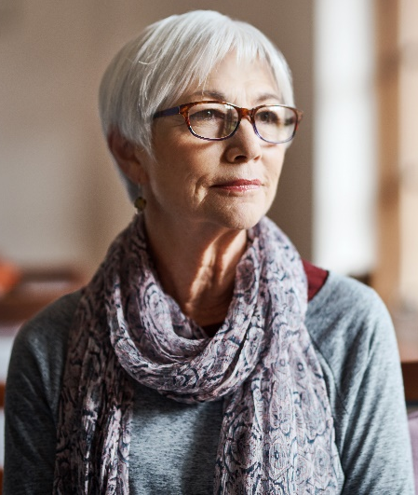

Mary McLeod
Name
Age 62
Employment Retired
Personality keywords
Introvert
Feeling
Sensory
Judging
Mary is a Carer for her older sister.
She enjoys going out and practicing yoga to keep her mind & body fit.
Mary wants to view the data on the NHS website in a manner that is easy to use & comprehend.
Biog
Goals
Personal motivations
Find out current COVID
statistics for her sister.
Social motivations
Decide how safe it is to take
her sister out.
Financial motivations
Decide whether to prepay for
a course of yoga classes.
Image
Display graphs that are large & easy to comprehend with User Interface buttons having high contrast that are arranged with a layout that is user-friendly & easy to navigate.
Use small, low contrast, unordered buttons.
Display graphs that are not easy to comprehend.
We must:
We must not:
Phone
Tablet
Laptop
Desktop
Social net

